Slide 1
Java SE 8 Book Presentation
Chapter 5 – Working With Java Data Types

Slide 2
5.1 Data types in Java – 5.1.1 Data types and Variable types
Data Type = name given for the specific type of value (e.g: Integer = “int” in Java) => classify different types of value allows us to treat each type of data differently and also perform specialized operations on that specific type of value (e.g: we all know what to do with addition operation on ”int” value but not on “Boolean” value). Data type also determines the space required to store that data (e.g: bytes = 8 bits, int = 32 bits). Data type is important since it tells the compiler which type of data we are working on right now (e.g: “int i;” indicates that we are working with integer variable) => the compiler will then allow us to only store integer value on that variable. Defining a variable of a certain types = have a right to perform specific operation on that value
I) Primitive Data Types
) Designed for working with raw data (int, float, char, double, long, short)
) Java automatically understands these data types, knows how much space they take up, what can be done with them
) It is the basic block of Java
) Combining more primitive datatypes using ”class” => more complex data types
II) Reference Data Types
) Design for working with special data types that Java doesn’t know (Java doesn’t know about Student objs, Course objs and Grade objs) => Java doesn’t know which type of operation they support, what is their properties => Java expected us to define all of these. Java has interface, class and enum to handle these definition job, therefore, we are creating reference data type.
) Reference data type is formed by combining many primitive and reference data types
) If something belongs to class, interface, enum => Reference Data Types

Slide 3
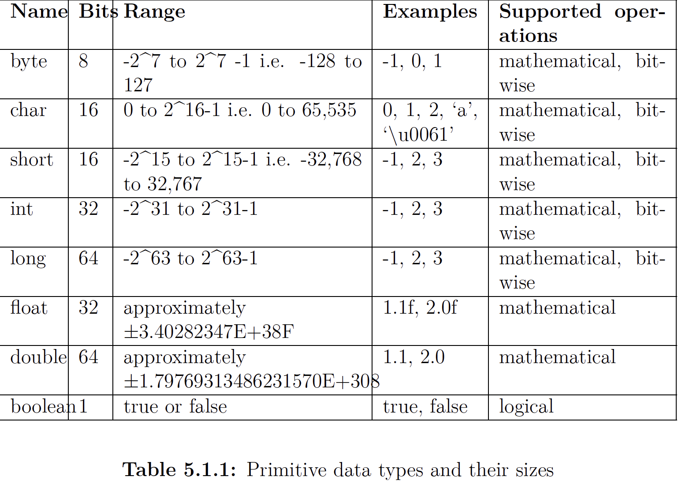
5.1 Data types in Java – 5.1.1 Data types and Variable types

Slide 4
5.1 Data types in Java – 5.1.1 Data types and Variable types
Byte, char, int, long, short: These are called integral data types since they store integral values
char is also an integral type and can store numerical values, however, it cannot store negative numbers since the number it stores will be interpreted into Unicode Character
float / double: Store large but imprecise value
Boolean: Store only 2 values => only requires 1 bit of memory. However, its size is not defined since a chunk of memory is measured differently depending on the type of OS (if the OS version is 32 bits => the Boolean data type takes up to 4 bytes)
A word on “void” keyword and “null” keyword
) ”void” is a keyword in Java and it means “nothing”. It is used as a “return type” of a method to indicate that this method will never return anything => “void” is a type specification and not a data type => a method could be declared as “void” but a variable can’t be declared as “void”.
) “null” is a valid VALUE, not a data type. When a method returns “null”, it is just a special case where the invocation returns an invalid reference but it doesn’t mean that the method always returns nothing. Therefore, we cannot use ”void” as a return statement => return “null” is valid whilst return “void” is invalid. Moreover, a method declared as “void” could omit the return statement or just leave it as “return;”

Slide 5
5.2 Difference between reference variables and primitive variables – 5.2.1 – Reference variable and primitive variable
- ) If we define “int i;”, it means that the variable type is “int”
) If we define “String str;”, it means that the variable type is “java.lang.String”
The difference between primitive variables and reference variables is the stored value inside the variable. While primitive data type store actual values inside, reference variables store the ”memory address” to the real data. For example, ”int i = 10” will store the actual “10” while “String str = hello” will store the RAM address to that ”hello” string. When we are performing operation on reference variable, the actual operation is actually taking place on another location inside RAM
Both values support assignment using “=“ sign
We can only assign the address of the object INDIRECTLY to the reference variable since Java doesn’t allow developers to touch the memory programmatically. For example, “String str = “hello”” will just mean that we are assigning the memory address where “hello” resides. Also, “String str2 = str” will also mean that we just copying the address value to “hello” from ”str” to “str2”
The size of a primitive variable depends on the actual data that the variable is storing
The size of a reference variable depends on the addressing mechanism of the OS
The size of the reference data type such as class depends on the number of instance variables used inside the class since either of them is primitive or referencing variable => their size could be just the sum of all primitive and reference variable.
The size never change for a given class, all instances created will have the same size as each other (no matter what values its instance variable holds) => no need to calculate memory taken space by an instance at runtime

Slide 6
5.3 Declare and initialize variables – 5.3.1 Declaration and Definition
(CODE ILLUSTRATION)

Slide 7
5.3 Declare and initialize variables – 5.3.2 Declare and initialize variable
(CODE ILLUSTRATION)
Naming rule for a variable:
+) Must be a valid Java identifier
+) Always start with a lowercase letter (constant variable always in uppercase)
+) Variable generated by code generation will always start with a “$” or “_”

Slide 8
5.3 Declare and initialize variables – 5.3.3 Uninitialized variables and default value
(CODE ILLUSTRATION)

Slide 9
5.3 Declare and initialize variables – 5.3.3 Uninitialized variables and default value
Java code runs flawlessly if the uninitialized variables aren’t used
Static and instance variables initialize with default values if we don’t initialize them explicitly
Java doesn’t initialize local variables
To make sure that the variable is always initialized with a predetermined value before they are accessed, Java has 2 different approaches
I) JVM automatically initializes the variable
In this approach, when developers don’t initialize the instance and static variable explicitly, JVM will automatically initialize the variable with default values (these values will be 0 or (0.0) for all numerical variables, “false” for Boolean and ”null” for reference variable) (CODE ILLUSTRATION)
II) Force the programmer to initialize the variable
- In this approach, the compiler will raise an error if it sees any variable that might be accessed without initialization. This approach is used for local variables (the variable declared in a method or a block)
- If at any point the compiler realizes that a variable might not have been initialized before being accessed, it will flag an error. This is called the “definite assignment” principle - a variable must have an initialized value before access to its value occurs. (CODE ILLUSTRATION)

Slide 10
5.3 Declare and initialize variables – 5.3.3 Uninitialized variables and default value
A compiler must perform a “flow analysis”, which analyzes all possible execution paths that have the case where a variable is accessed without initialization. However, the compiler can’t execute code => it can’t make inferences based on the RESULT from the execution of the code. Still, it can make inferences based on the information available at the compile time. There is a special variable called “compile-time constant” – the only variable that the compiler can understand during the COMPILATION
=> JVM will initialize static and instance variables to default values if we do not initialize them explicitly. But with local variables, we have to initialize them explicitly, or we will receive errors from the compiler

Slide 11
5.3 Declare and initialize variables – 5.3.4 Assigning values to variables
Literal is “a notion to represents a fixed value in source code”
+) “true” and “false” is a literal because it represents the Boolean value
+) 10 is always a 10, it represents “int” value
+) “hello” is a string literal since it represent the String object by assigning the memory address to the real “hello” String object
+) ‘a” character is also a “char” literal because it represents a character
+) However, “String” and “name” in the statement “String name;” is not a literal since String and ”name” is defined by developers, not Java
- A few important points about Java literal
+) To read large numbers more easily, Java allows us to use ”_” between the 0s (e.g 1_000_000 for “int” data type or 1_000_000.0 for ”float” data type
+) “int literal” is the number without the decimal point, “double literal” is the number with the decimal point
+) A “long literal” can be written by appending either lowercase or uppercase “l” to the end of the number (e.g 1234L or 1234l)
+) A “float literal” can be written by appending either lowercase or uppercase “f” to the end of the number (e.g 1234f or 1234F)
+) A “char” literal can be written by enclosing the character with a single quote ‘’ (e.g: ‘a’ or ‘A’). Since it may not be always possible to type the character you want, Java allows us to write ”char” literal by using something called “hexadecimal Unicode format” (“\uxxxx”).
+) The “xxxx” is the hexadecimal value for the character that has been already defined in Unicode format
+) We can also write special character using the “escape character” (“\”)
+) There is only 2 Boolean literal (true and false)
+) “null” is also a literal, it means a reference variable is pointing to “nothing”

Slide 12
5.3 Declare and initialize variables – 5.3.4 Assigning values to variables
Java also allows us to write numerical values in octal, hexadecimal and binary
+) For hexadecimal, the value must start with a “0x” or “0X” and must be followed by one or more hexadecimal digits (e.g: 0xF = 15 in decimal)
+) For octal, the value must start with a 0 and must follow with one or more octal digits (017 in octal = 15 in decimal)
+) For binary, the value must start with a “0a” or “0B” and must be followed with one or more binary digits (0 and 1)
Assignment using another variable (CODE ILLUSTRATION)
Assignment using return value of a method (CODE ILLUSTRATION)
Assignment value of one type to a variable of another type: Assigning primitive variables with different types is possible in Java
+) Simple assignments involving primitive types: This include the assignment of compile time constant and the concept of casting for primitive data type
+) Primitive assignments involving mathematical/arithmetic operators: This includes values generated by binary/compound operators and the concept of implicit widening/narrowing of primitives (this will be further discussed in Chapter 6)
+) Assignments involving reference types – Casting reference types (Upcast – Downcast) (Already learnt this)

Slide 13
5.3 Declare and initialize variables – 5.3.4 Assigning values to variables
Primitive Assignment
(CODE ILLUSTRATION)
- Assigning a smaller type to a larger type is called “widening conversion” or “implicit widening conversion”. We could compare this with transferring water from a smaller bucket to a larger bucket, there will be no spillage since the water in the smaller bucket is already smaller than the volume of the larger bucket
– But if we try to assign a value from a larger variable to a smaller variable, there will be ”spillage” which means loss of information. Therefore, Java compiler doesn’t allow us to do this (CODE ILLUSTRATION)
- However, if the larger bucket isn’t full and the volume of the water inside the large bucket is equal to the volume of the smaller bucket? => There will be no spillage at this time => The compiler should allow us to assign the larger variable to the smaller variable => It does allow us but with A CONDITION
The problem is that the compiler cannot execute codes => it cannot determine whether the size of the source variable fits with the target variable. For example, 10 is an “int literal” and it is an “int” not a “byte”, although an “int” is larger than a “byte”, we still can do ”byte b = 10;” since 10 is fit into a byte. However, “byte b = 128;” isn’t compilable since the range of a byte is from -128 to 127.
However, if we try ”final int i = 4;”, ”byte b = i;”, this code will be compilable since ”i” is a compile time constant.
Therefore, we can assign a compile time constant to a target variable ONLY IF the source variable has a size that is smaller or equal to the target variable => This is called “implicit narrowing” (NOTE: This is only applicable to variable assignment, not for method. If we try to define a method with input type is “int” and we try to pass in “long” => it won’t compile, even with the pass in size is smaller than the input type size)

Slide 14
5.3 Declare and initialize variables – 5.3.4 Assigning values to variables
If the source variable is not a constant => The compiler will force the developer to promise that the source variable's size fits the target variable. And this promise is called “casting”
Java allows us to cast the value from one primitive type to another primitive type by specifying the target type within parentheses. (CODE ILLUSTRATION)
We can use “casting” to assign any primitive integral (byte, char, short, long, int) or floating point value (float, double) to any other integral and floating point value
Boolean value cannot be cast
“Casting” will tell the compiler that just add the value to the variable and not worry about the spillage

Slide 15
5.3 Declare and initialize variables – 5.3.5 Final variables
A “final” variable is a type of variable that can’t assign any other values once it has a value assigned to it => It is a constant (CODE ILLUSTRATION)

Slide 16
5.4 Declare and instantiate Java objects - 5.4.1 Declare and instantiate Java objects
The reference type name could be the simple class name or FQCN (if you don’t want to import a class or to use multiple classes with the same method name) (CODE ILLUSTRATION)

